Slide 1
Lean Principles
Card Game

Slide 2
Game (Simulation)
Objective: Construct a 13 story building as quickly as possible, working within the constraint parameters for each phase (1-6)
Each card represents the resources (labor, materials, equipment) to construct a trade-specific component of one of the thirteen floors.
The four suits represent the specific trades (or waste):
Player 1 (Clubs): Structural Contractor
Player 2 (Diamonds): Mechanical Contractor
Player 3 (Hearts): Finishing Contractor
Spades: waste or non-value adding activities
Each floor (row of cards) of the building is represented by the face value of the card (Ace = first floor, 2 = second floor, etc).

Slide 3
How to Play
Shuffle cards in a loose pile, face up on the table.
Choose a spot where all three players will place their cards.
Use a timer to see how long each phase takes.
Players select their cards from the pile. Note: each phase of the game has different rules.
Players place their card from lowest (Ace) to highest (King) in their designated area.
Game is complete when the King of Hearts is played as the last card.
Structural (club) cards can be played at any time.
Mechanical (diamond) cards can be played when the same value club card has been placed.
Finishing (heart cards) can be played when the same value diamond card has been placed.

Slide 4
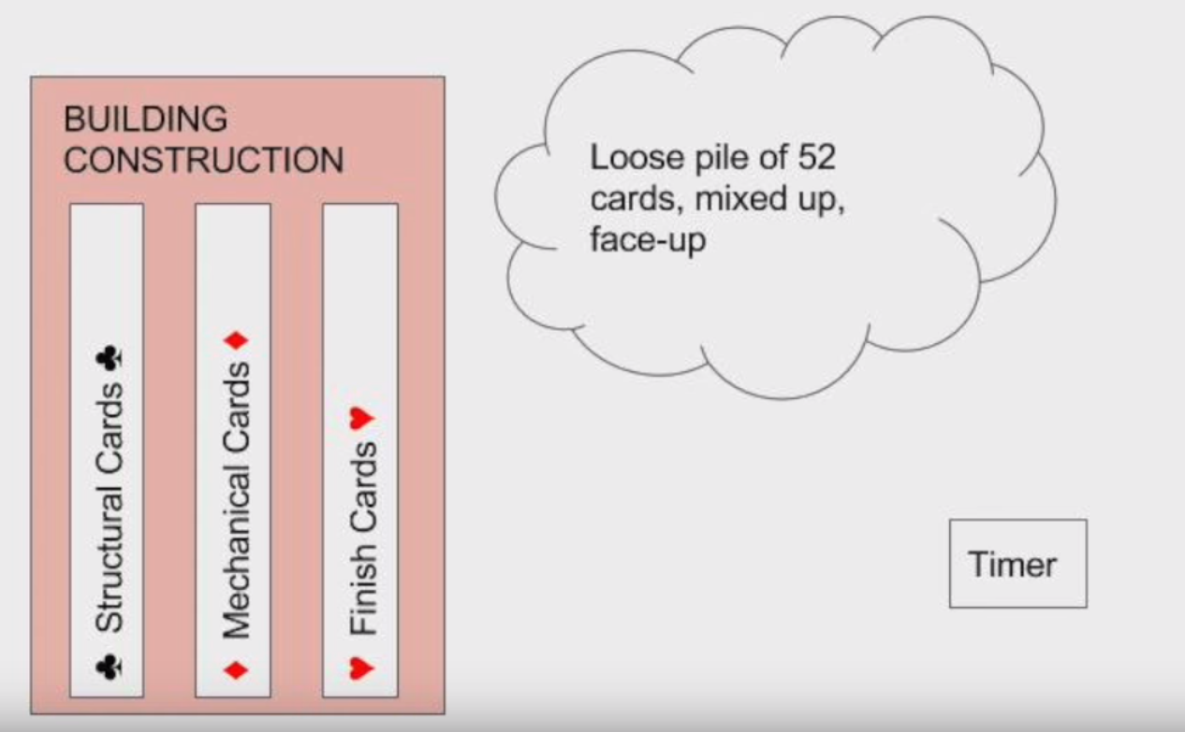
Layout

Slide 5
Demonstration

Slide 6
Phase 1 (Unilateral Construction Chaos)
Setup: All cards are face-up in a loose, mixed pile
RULES:
Players may pick up only the one card they can play.
No sorting of the cards is allowed.
No talking, collaboration, or teamwork.
*Players will play phase 1 twice.
First time = practice
Second time = timed event – record your time!

Slide 7
Phase 1: Post Play Discussion
How long did it take your team to complete construction?
Did you do better the second time?
Is this faster/slower than you expected?
Where there any quality control problems?
What are some suggestions to improve performance time?

Slide 8
Phase 2 (Improved Site Laydown Org.)
Setup: All cards are face-up in a loose, mixed pile
RULES:
Players may gather all of their cards.
Players may sort their cards during play.
No talking, collaboration, or teamwork.
PREDICTION:
Is it faster if players sort cards while clock is running?
How long will it take your group to complete this phase?

Slide 9
Phase 2: Post Play Discussion
Was your team performance faster or slower? Why?
Which lean concepts were used to improve performance?
What might you change to further improve performance time?

Slide 10
Phase 3 (Collaboration)
Setup: All cards are face-up in a loose, mixed pile
RULES:
Players may gather all of their cards.
Players may sort their cards during play.
Players may talk and collaborate, assist each other.
PREDICTION:
Will collaboration result in faster time?
How long will it take your group to complete this phase?

Slide 11
Phase 3: Post Play Discussion
Was your team performance faster or slower? Why?
Which lean concepts were used to improve performance?
What might you change to further improve performance time?

Slide 12
Phase 4 (Reducing Waste)
Setup: Set aside all waste (space) cards. Remaining cards are face-up in a loose, mixed pile
RULES:
Players may gather all of their cards.
Players may sort their cards during play.
Players may talk and collaborate, assist each other.
PREDICTION:
Will collaboration result in faster time?
How long will it take your group to complete this phase?

Slide 13
Phase 4: Post Play Discussion
Was your team performance faster or slower? Why?
Which lean concepts were used to improve performance?
What might you change to further improve performance time?

Slide 14
Phase 5 (Improved Material Management)
Setup: Set aside all waste (space) cards. Remaining cards are stacked in 3 same suit piles (not sorted by face value)
RULES:
Players may gather all of their cards.
Players may sort their cards during play.
Players may talk and collaborate, assist each other.
PREDICTION:
Will collaboration result in faster time?
How long will it take your group to complete this phase?

Slide 15
Phase 5: Post Play Discussion
Was your team performance faster or slower? Why?
Which lean concepts were used to improve performance?
What might you change to further improve performance time?

Slide 16
Phase 6 (Optimized Material Management)
Setup: Set aside all waste (space) cards. Remaining cards are stacked in 3 same suit piles AND sorted by face value
RULES:
Players may gather all of their cards.
Players may sort their cards during play.
Players may talk and collaborate, assist each other.
PREDICTION:
Will collaboration result in faster time?
How long will it take your group to complete this phase?

Slide 17
Phase 6: Post Play Discussion
Was your team performance faster or slower? Why?
Which lean concepts were used to improve performance?
What might you change to further improve performance time?

Slide 18
Results
Phase 1 (Unilateral Construction Chaos):
Phase 2 (Improved Site Organization):
Phase 3 (Collaboration):
Phase 4 (Elimination of Waste):
Phase 5 (Improved Material Management):
Phase 6 (Optimized Material Management):

Slide 19

Questions

